Slide 1
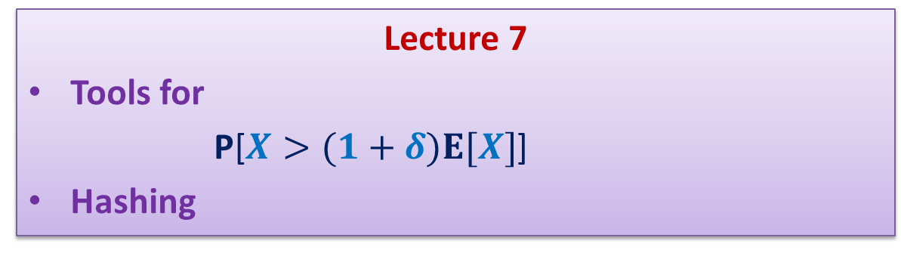
Randomized Algorithms CS648
Lecture 7
Tools for
P[$X>(1+δ)E[X]$]
Hashing

Slide 2
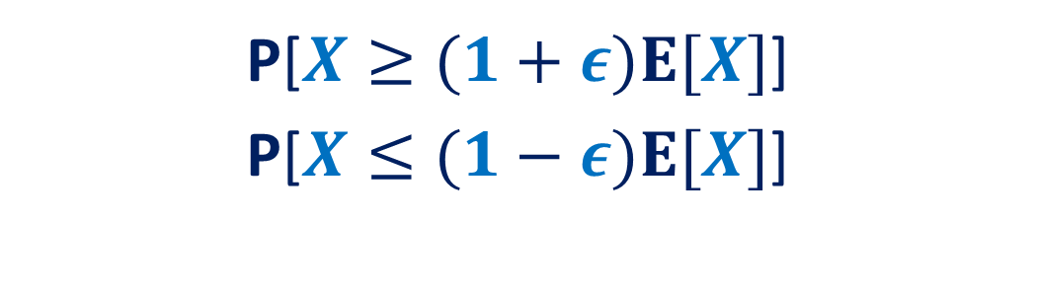
How to show
P[$X≥(1+ε)E[X]$]
P[$X≤(1−ε)E[X]$]

Slide 3
Tools
Markov’s Inequality
Chebyshev’s Inequality
Chernoff bound

Slide 4
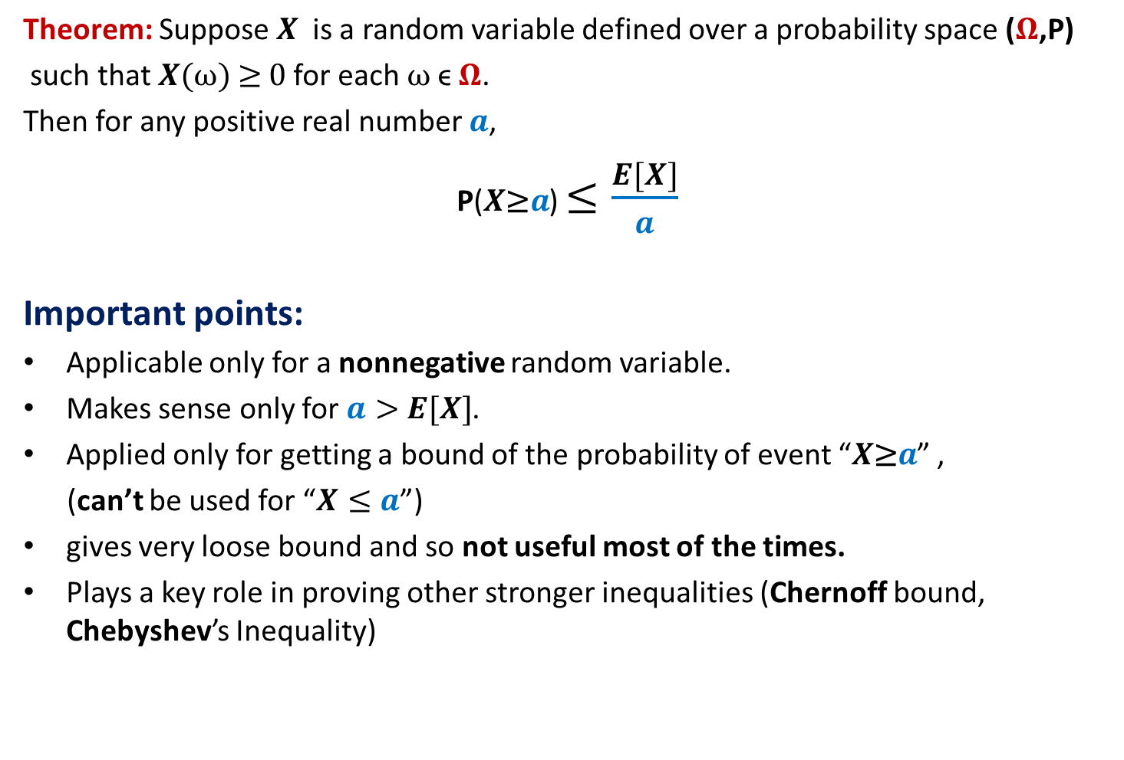
Markov’s Inequality
Theorem: Suppose $X$is a random variable defined over a probability space ($Ω$,P)
such that $X(ω)$≥ 0 for each $ω$ϵ $Ω$.
Then for any positive real number $a$,
P($X\text{≥}a$) $≤\frac{E[X]}{a}$
Important points:
Applicable only for a nonnegative random variable.
Makes sense only for $a>$ $E[X]$.
Applied only for getting a bound of the probability of event “$X\text{≥}a$” ,
(can’t be used for “$X≤a$”)
gives very loose bound and so not useful most of the times.
Plays a key role in proving other stronger inequalities (Chernoff bound, Chebyshev’s Inequality)

Slide 5

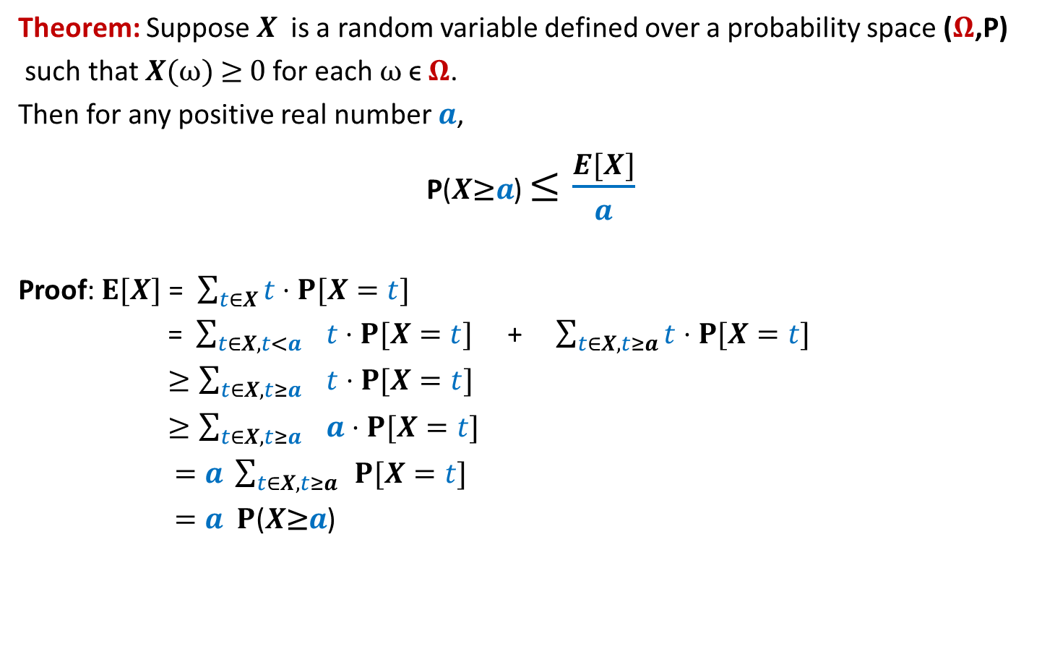
Markov’s Inequality
Theorem: Suppose $X$is a random variable defined over a probability space ($Ω$,P)
such that $X(ω)$≥ 0 for each $ω$ϵ $Ω$.
Then for any positive real number $a$,
P($X\text{≥}a$) $≤\frac{E[X]}{a}$
Proof: $E[X]$ = $\sum_{t∈X}{t}⋅P[X=t]$
= $\sum_{t∈X,t<a}{ t}⋅P[X=t]$ + $\sum_{t∈X,t≥a}{t}⋅P[X=t]$
$≥\sum_{t∈X,t≥a}{ t}⋅P[X=t]$
$≥\sum_{t∈X,t≥a}{ a}⋅P[X=t]$
$=a \sum_{t∈X,t≥a}{ }P[X=t]$
$=a P$($X\text{≥}a$)
$a P$($X\text{≥}a$)

Slide 6
Hashing
(part 1)

Slide 7

Problem Definition
$U=\left\{1,2,…,m\right\}$ called universe
$S⊆U$ and $s=|S|$
$s≪$ $m$
Examples:
$m={10}^{18}$ , $s={10}^{3}$
Aim
Build a data structure for a given $S$to support the search query :
“Does $i∈$ $S$ ?” for any $i∈U$.

Slide 8
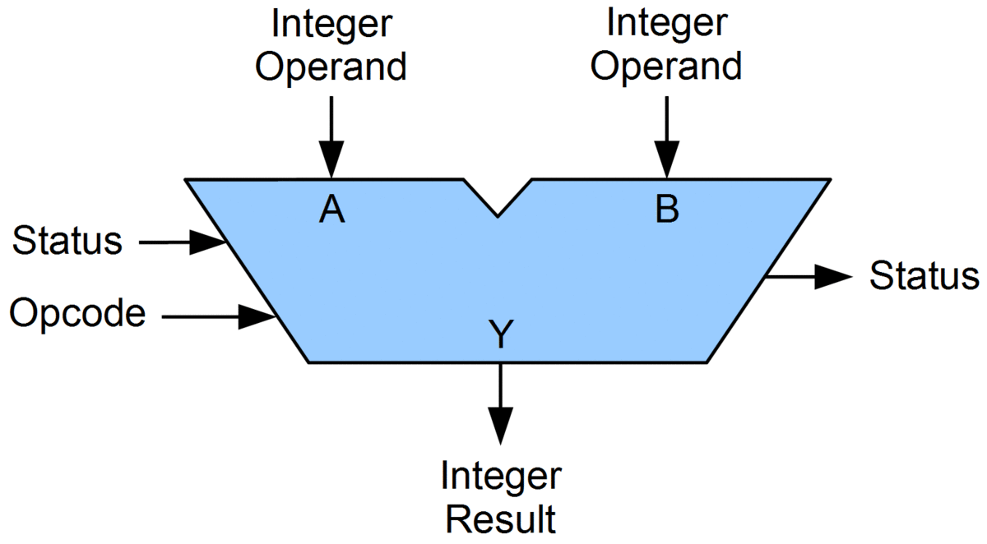

Solutions
with worst case guarantees
Practical solution with no worst case guarantees
 | Query time | Data structure | Space
Static $S$ | O($log s$) | Array | O($s$)
Dynamic $S$ | O($log s$) | Red-Black trees | O($s$)
Dynamic $S$ | O($1$) | Array
Makes use of comparison
as the basic operation
O($m$)
Impractical
Makes use of fast arithmietic operations on integers
Hashing
ALU
Few cycles for an arithmetic operation

Slide 9


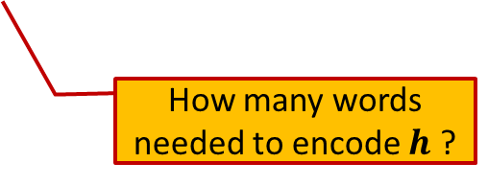
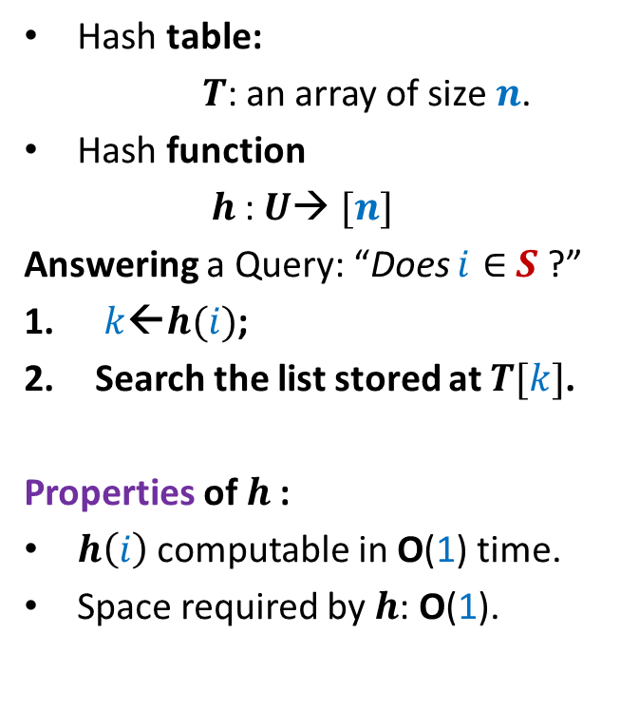

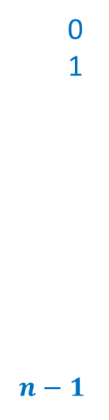

Hashing
Hash table:
$T$: an array of size $n$.
Hash function
$h$: $U$→ $[n]$
Answering a Query: “Does $i∈$ $S$ ?”
$k$←$h(i)$;
Search the list stored at $T[k]$.
Properties of $h$:
$h\left(i\right)$ computable in O(1) time.
Space required by $h$: O(1).
Elements of $S$
$$T$$
0
1
$$n−1$$
$$⋮$$
$$⋮$$
How many words needed to encode $h$ ?

Slide 10
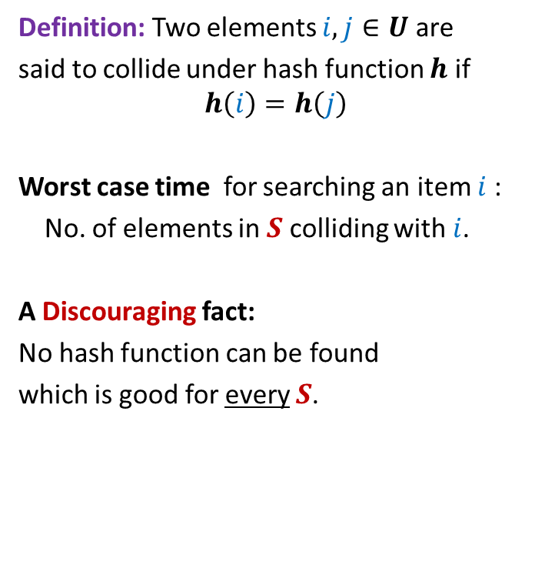
Collision
Definition: Two elements $i,j∈U$ are
said to collide under hash function $h$ if
$$h\left(i\right)=h\left(j\right)$$
Worst case time for searching an item $i$:
No. of elements in $S$ colliding with $i$.
A Discouraging fact:
No hash function can be found
which is good for every $S$.
$$T$$
0
1
$$n−1$$
$$⋮$$
$$⋮$$

Slide 11


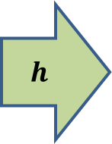


Collision
1
2
Proof:
Let $h$ be any hash function.
By averaging argument,
at least $m/n$ elements from $U$
are mapped to a single index in $T$.
Since $s≪$ $m$, hence $s<m/n$.
So there exists a set of $s$ elements
all mapped to single index in $T$.
$$T$$
0
1
$$n−1$$
$$h$$
$$⋮$$
$$⋯$$
$$⋮$$
$$s$$
$$m$$

Slide 12
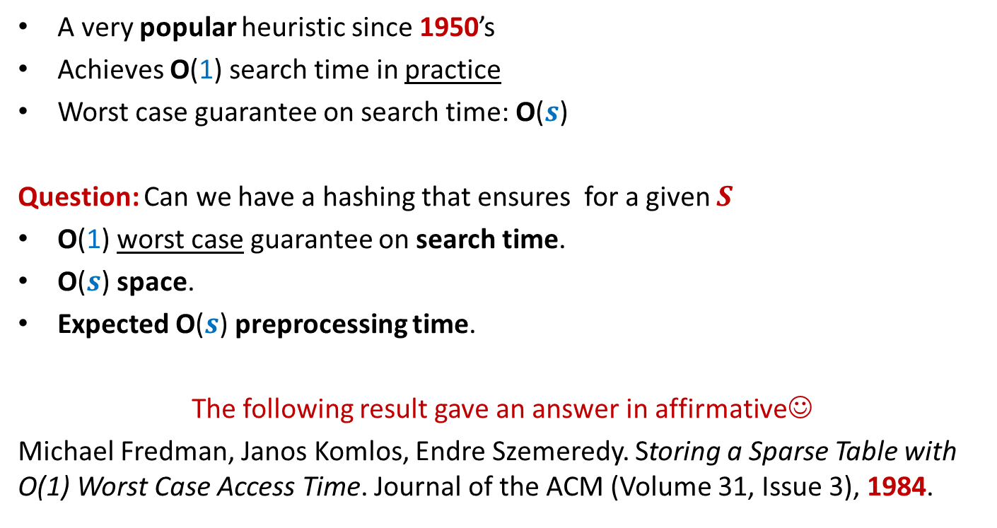
History of Hashing
A very popular heuristic since 1950’s
Achieves O(1) search time in practice
Worst case guarantee on search time: O($s$)
Question: Can we have a hashing that ensures for a given $S$
O(1) worst case guarantee on search time.
O($s$) space.
Expected O($s$) preprocessing time.
The following result gave an answer in affirmative☺
Michael Fredman, Janos Komlos, Endre Szemeredy. Storing a Sparse Table with O(1) Worst Case Access Time. Journal of the ACM (Volume 31, Issue 3), 1984.

Slide 13
Why does hashing work so well in Practice ?

Slide 14
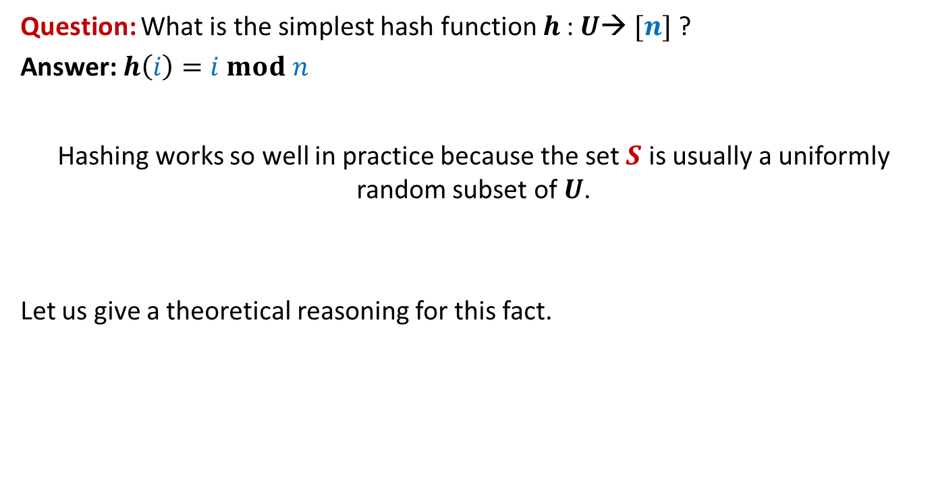
Why does hashing work so well in Practice ?
Question: What is the simplest hash function $h$: $U$→ $[n]$ ?
Answer: $h\left(i\right)=i mod n$
Hashing works so well in practice because the set $S$ is usually a uniformly random subset of $U$.
Let us give a theoretical reasoning for this fact.

Slide 15




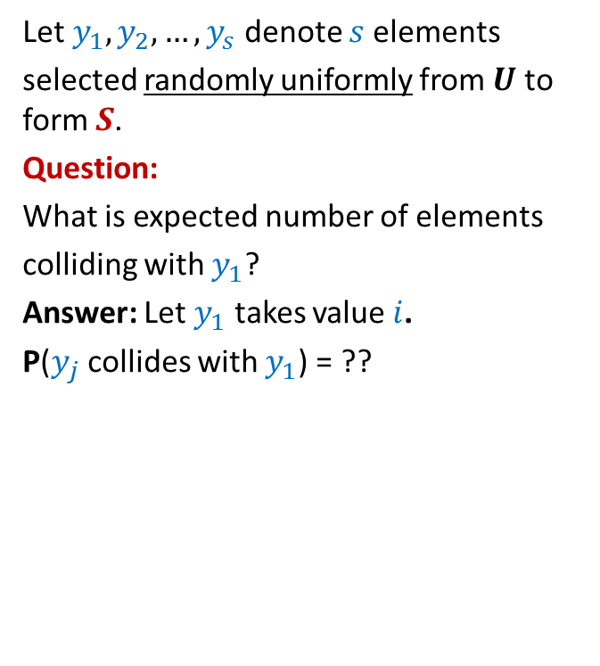






Why does hashing work so well in Practice ?
1
2
Let $y_{1},y_{2},…,y_{s}$ denote $s$elements
selected randomly uniformly from $U$ to form $S$.
Question:
What is expected number of elements
colliding with $y_{1}$?
Answer: Let $y_{1}$ takes value $i$.
P($y_{j}$ collides with $y_{1}$) = ??
$$⋮$$
$$i−n$$
$$i$$
How many possible values can $y_{j}$ take ?
$$i+n$$
$$m−1$$
$$i+2n$$
How many possible values can collide with $i$ ?
$$i+3n$$
$$⋮$$
m

Slide 16
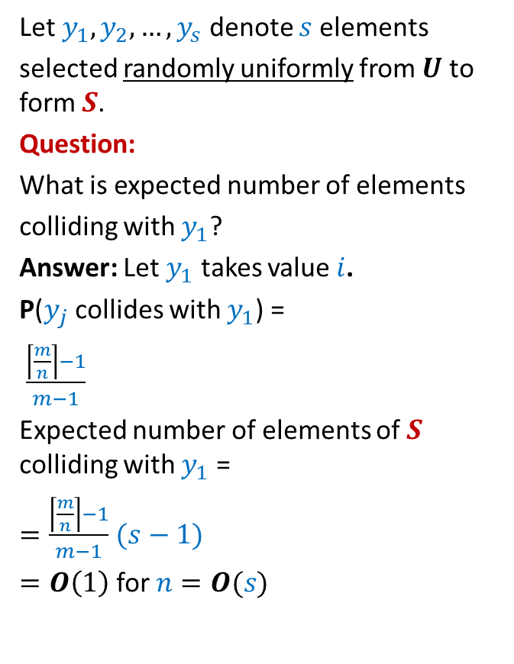


Why does hashing work so well in Practice ?
1
2
Let $y_{1},y_{2},…,y_{s}$ denote $s$elements
selected randomly uniformly from $U$ to form $S$.
Question:
What is expected number of elements
colliding with $y_{1}$?
Answer: Let $y_{1}$ takes value $i$.
P($y_{j}$ collides with $y_{1}$) =
$\frac{\left\lceil \frac{m}{n}\right\rceil −1}{m−1}$
Expected number of elements of $S$ colliding with $y_{1}$ =
$=\frac{\left\lceil \frac{m}{n}\right\rceil −1}{m−1}$ $(s−1)$
$=O\left(1\right)$ for $n=O(s)$
$$⋮$$
$$i−n$$
Values which may collide with $i$ under the hash function $h\left(x\right)=x mod n$
$$i$$
$$i+n$$
$$i+2n$$
$<\left\lceil \frac{m}{n}\right\rceil \frac{s}{m}$
$$i+3n$$
$$⋮$$
m

Slide 17
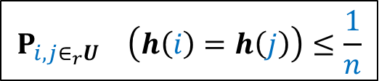


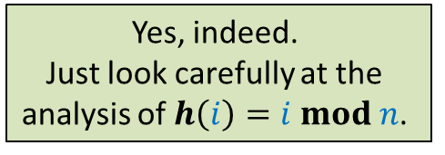
Why does hashing work so well in Practice ?
Conclusion
$h\left(i\right)=i mod n$ works so well because
for a uniformly random subset of $U$,
the expected number of collision at an index of $T$ is O(1).
Homework:
Show that for every hash function $h$ will also do well in practice provided it satisfies the following inequality.
Can there be other hash functions as well that will do well in practice ?
Yes, indeed.
Just look carefully at the
analysis of $h\left(i\right)=i mod n$.
$$P_{i,j∈_{r}U} \left(h\left(i\right)=h\left(j\right)\right)≤\frac{1}{n}$$
“How can we achieve worst case O(1) search time for a given set $S$.”
But it is easy to fool each such hash function
such that it achieves O(s) search time.

Slide 18
How to achieve worst case O(1) search time

Slide 19





Key idea to achieve worst case O(1) search time
A promising direction:
Find out a family of hash functions H such that
For any given $S$ , many of them are good.
Select a function randomly from H and try for $S$.
No hash function which is good for every $S$
A good hash function for a given $S$
Of course, no single hash function is good for every possible $S$.
But we may strive for a hash function which is good for a given $S$.
The notion of goodness is captured formally by Universal hash family in the following slide.

Slide 20

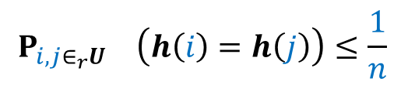
Universal Hash Family
Inspiration
from theoretical explanation of the popularity of hashing in practice
$$P_{i,j∈_{r}U} \left(h\left(i\right)=h\left(j\right)\right)≤\frac{1}{n}$$
$$h∈_{r}H$$

Slide 21

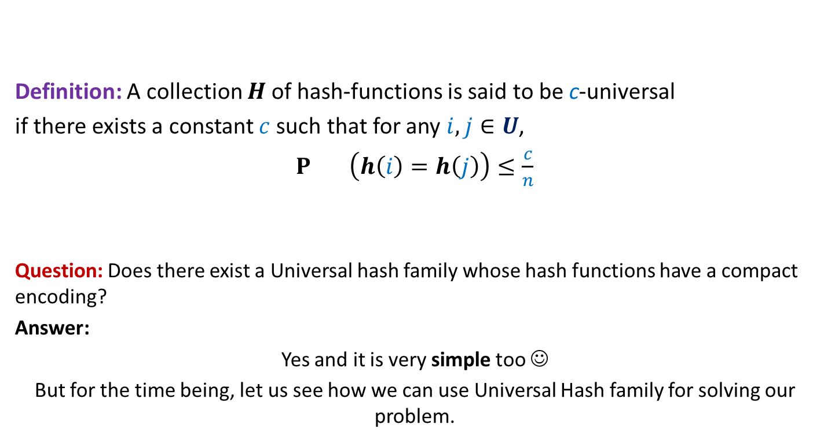
Universal Hash Family
Definition: A collection $H$of hash-functions is said to be c-universal
if there exists a constant $c$such that for any $i,j∈U$,
$P_{} \left(h\left(i\right)=h\left(j\right)\right)≤\frac{c}{n}$
Question: Does there exist a Universal hash family whose hash functions have a compact encoding?
Answer:
Yes and it is very simple too ☺
But for the time being, let us see how we can use Universal Hash family for solving our problem.
$$h∈_{r}H$$

Slide 22
Static Hashing worst Case O(1) search time
Michael Fredman, Janos Komlos, Endre Szemeredy.
Storing a Sparse Table with O(1) Worst Case Access Time.
Journal of the ACM (Volume 31, Issue 3), 1984.

Slide 23
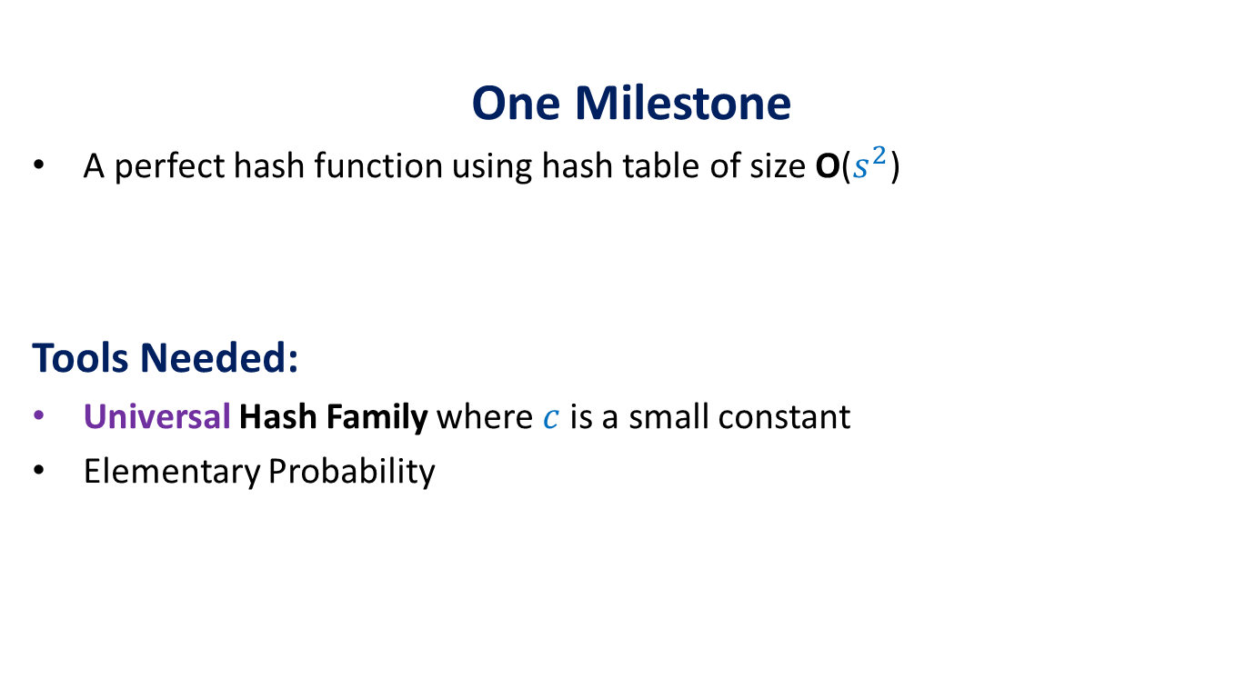
The Journey
One Milestone
A perfect hash function using hash table of size O($s^{2}$)
Tools Needed:
Universal Hash Family where $c$is a small constant
Elementary Probability

Slide 24
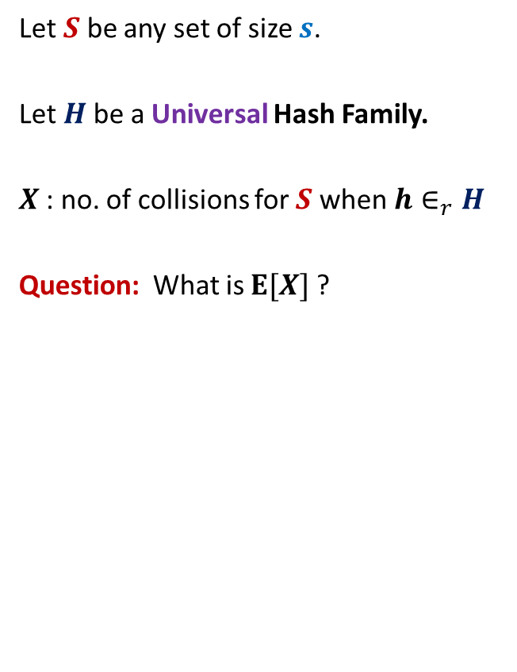


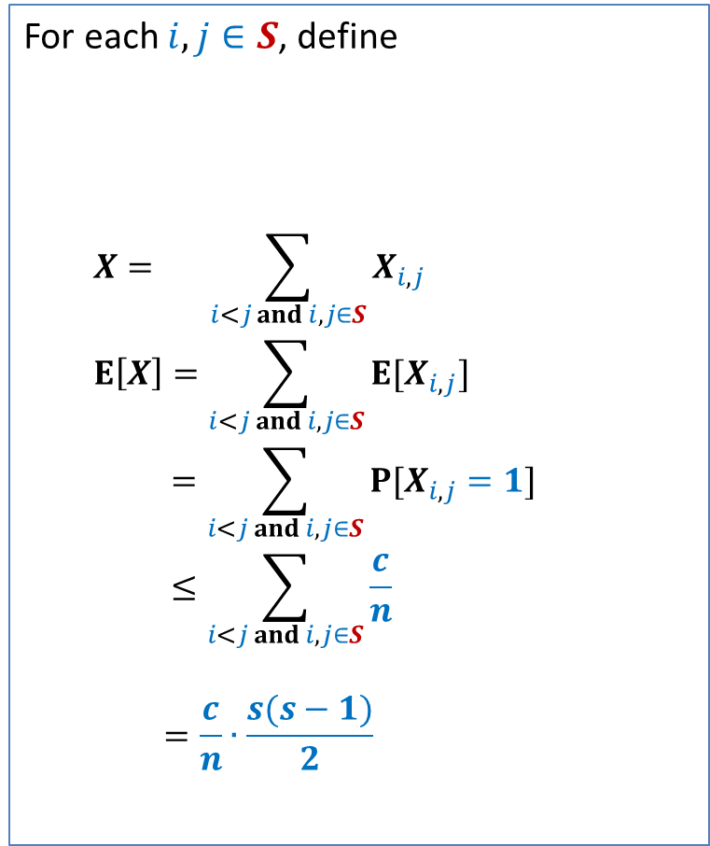
Perfect hashing using O($s^{2}$) space
Let $S$ be any set of size $s$.
Let $H$be a Universal Hash Family.
$X$: no. of collisions for $S$ when $h∈_{r}H$
Question: What is $E[X]$?
For each $i,j∈S$, define
$$X= \sum_{i<j and i,j∈S}{X_{i,j}}$$
$$E\left[X\right]=\sum_{i<j and i,j∈S}{E[X_{i,j}]}$$
$$=\sum_{i<j and i,j∈S}{P[X_{i,j}=1]}$$
$$≤\sum_{i<j and i,j∈S}{\frac{c}{n}}$$
$$=\frac{c}{n}∙\frac{s(s−1)}{2}$$
$$X_{i,j}=\left\{\begin{aligned}1 if h\left(i\right)=h(j) \\ 0 otherwise \end{aligned}\right.$$

Slide 25
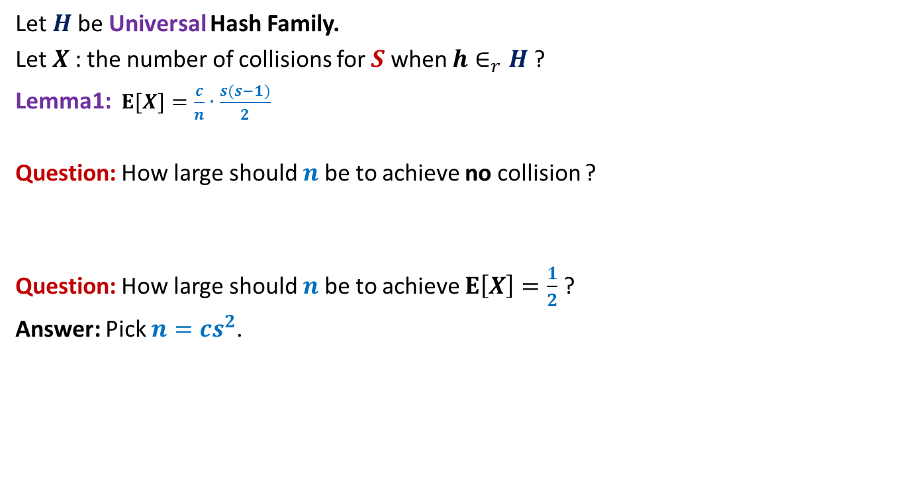
Perfect hashing using O($s^{2}$) space
Let $H$be Universal Hash Family.
Let $X$: the number of collisions for $S$ when $h∈_{r}H$?
Lemma1:$E[X]=\frac{c}{n}∙\frac{s(s−1)}{2}$
Question: How large should $n$be to achieve no collision ?
Question: How large should $n$be to achieve $E\left[X\right]=\frac{1}{2}$ ?
Answer: Pick $n=cs^{2}$.

Slide 26
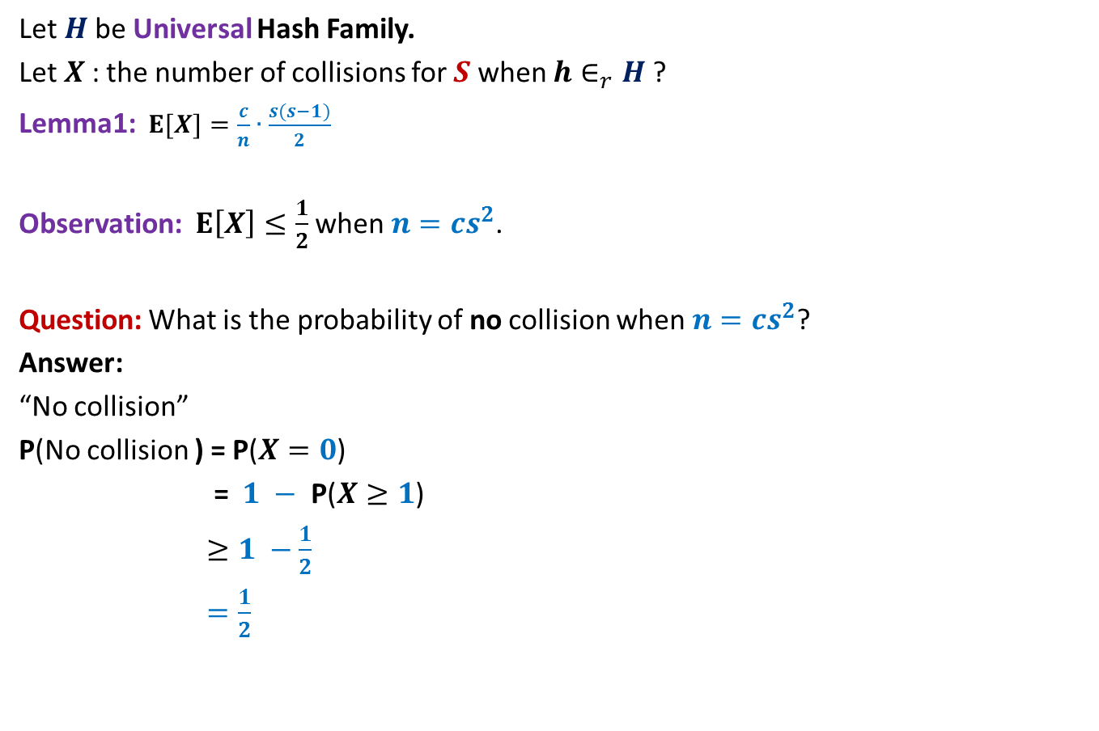

Perfect hashing using O($s^{2}$) space
Let $H$be Universal Hash Family.
Let $X$: the number of collisions for $S$ when $h∈_{r}H$?
Lemma1:$E[X]=\frac{c}{n}∙\frac{s(s−1)}{2}$
Observation: $E\left[X\right]≤\frac{1}{2}$ when $n=cs^{2}$.
Question: What is the probability of no collision when $n=cs^{2}$?
Answer:
“No collision”
P(No collision ) = P($X=0$)
= $1 −$ P($X≥1$)
$≥1 −\frac{1}{2}$
$=\frac{1}{2}$
⬄ “$X=0$”
Use Markov’s Inequality to bound it.

Slide 27
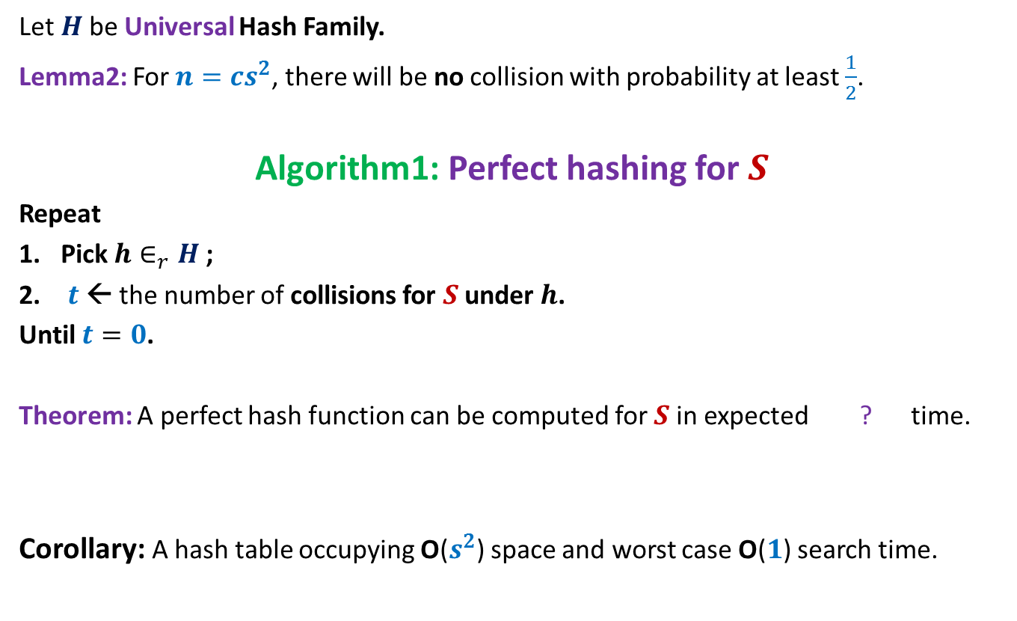

Perfect hashing using O($s^{2}$) space
Let $H$be Universal Hash Family.
Lemma2: For $n=cs^{2}$, there will be no collision with probability at least $\frac{1}{2}$.
Algorithm1: Perfect hashing for $S$
Repeat
Pick $h∈_{r}H$;
$t$← the number of collisions for $S$ under $h$.
Until $t=0$.
Theorem: A perfect hash function can be computed for $S$in expected ? time.
Corollary: A hash table occupying O($s^{2}$) space and worst case O($1$) search time.
O($s^{2}$)

Slide 28
Hashing with Optimal space And Worst case O(1) search time
Think over it before coming to next class ☺

